Slide 1

KultureHire
Data Analysis Learnternship
Understanding Career Aspirations of Gen Z
Sanskar Jaiswal

Slide 2

ROADMAP
1
3
5
7
Dashboards
Data Collection
Analyzing in SQL
Focused Excel dashboard
Developed three dashboards on customer service, finance and orders in EXCEL
Created a Google Form with tailored questions to collect data on Gen-Z's career aspirations.
Conducted data analysis using SQL, solving complex questions with the help of Common Table Expressions (CTEs) and joins.
Developed three focused dashboards for each area, incorporating KPIs, Pivot tables, measures, and groups in Excel.
2
4
6
8
Problem Statement
Cleaning in SQL
General Excel dashboard
Presentation
Developed a problem statement to explore and educate about the career aspirations of Gen-Z, addressing challenges and personal insights.
Loaded data dump into MySQL Workbench, cleaning and exploring high-level information using SQL basics.
Created a Excel dashboard summarizing Gen-Z's learning aspirations, mission aspirations, and manager aspirations.
Worked on an employer-focused project, creating recommendations and emphasizing the importance of storytelling in data.

Slide 3
STAGE 1:
PROBLEM STATEMENT

Slide 4
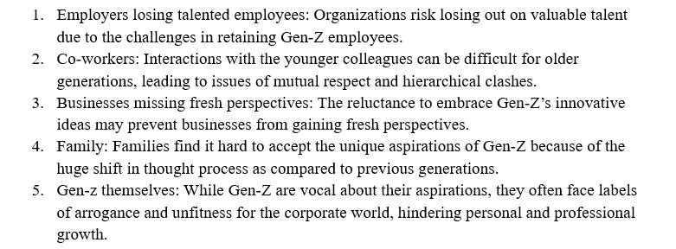
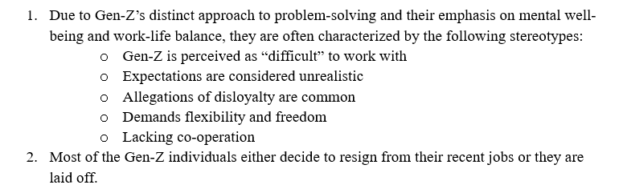
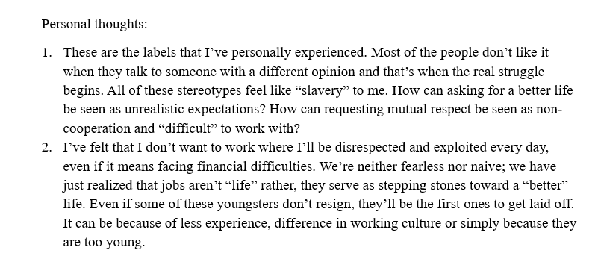
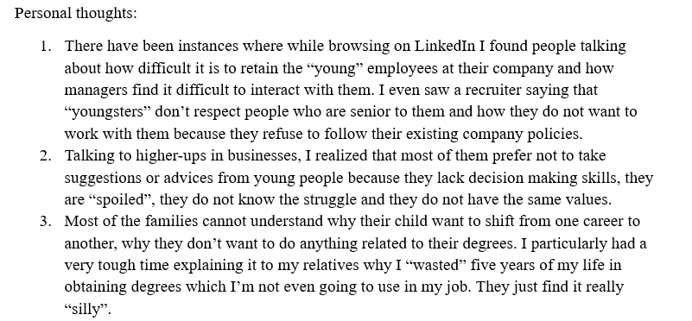
Who is affected?
What is happening?

Slide 5
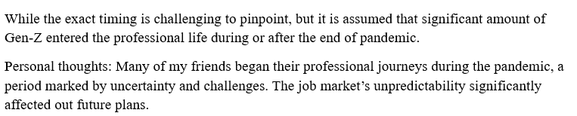
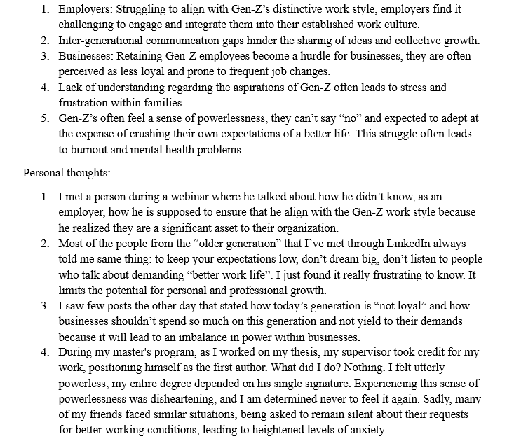
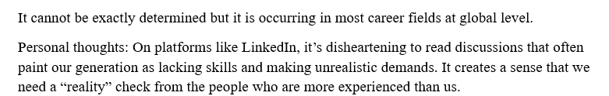
When is this happening?
Why is that happening?
Where is this happening?

Slide 6
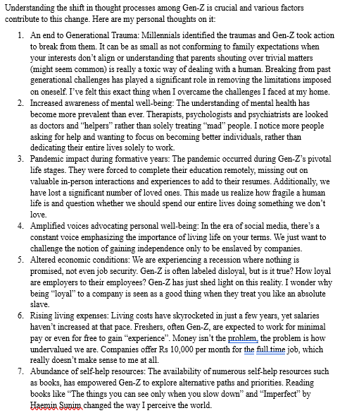
Personal thoughts on various factors contributing to this change in Gen Z
References
Authentically Gen Z: The Values, Aspirations & Drivers That Will Re-Define the Future of Work
Gen Z: The workers who want it all
Sentiments of Indian Gen Z workforce in 2023: Part I
Gen-Z Is Labeled As ‘Difficult’ In The Workplace, But There’s More To The Story
How does Gen Z see its place in the working world? With trepidation
Why Gen Z workers are already so burned out
Aspirations & Wants of Generation Z - A Study on the Work Force of the Future

Slide 7
STAGE 2:
DATA COLLECTION

Slide 8
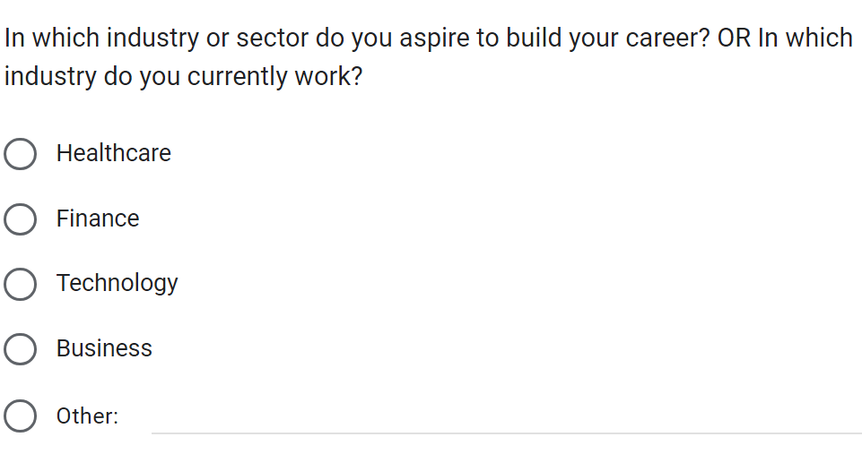
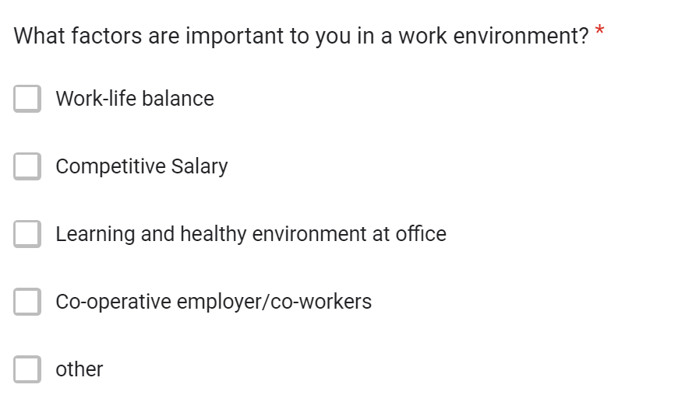
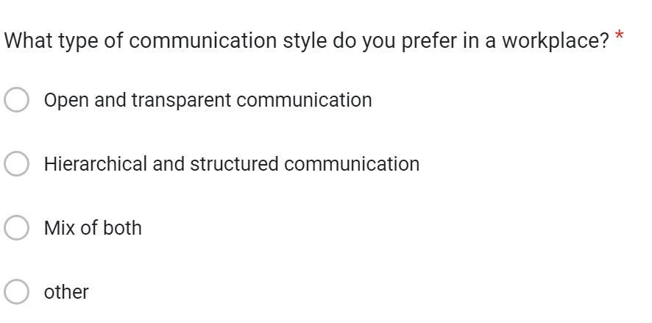

Slide 9
STAGE 3:
CLEANING & STANDARDIZING IN SQL

Slide 10
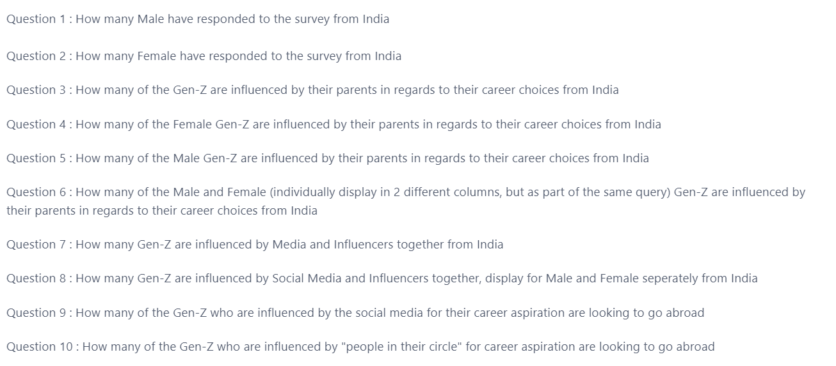

Slide 11
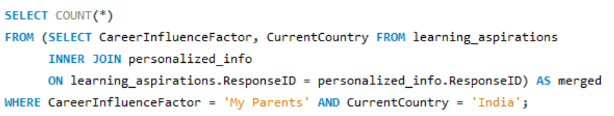
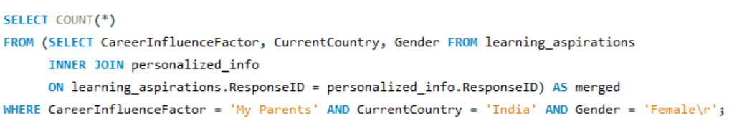
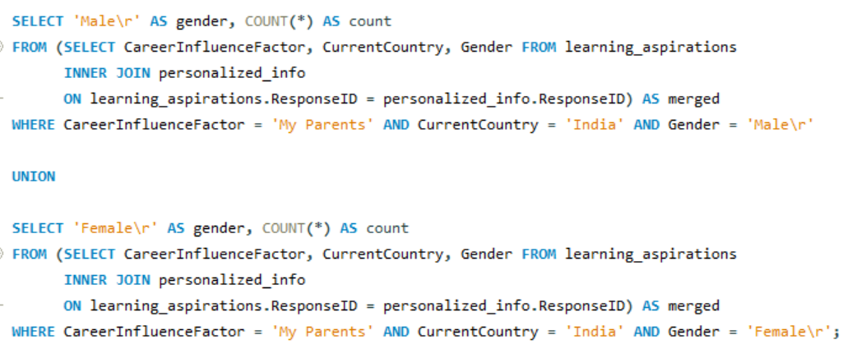
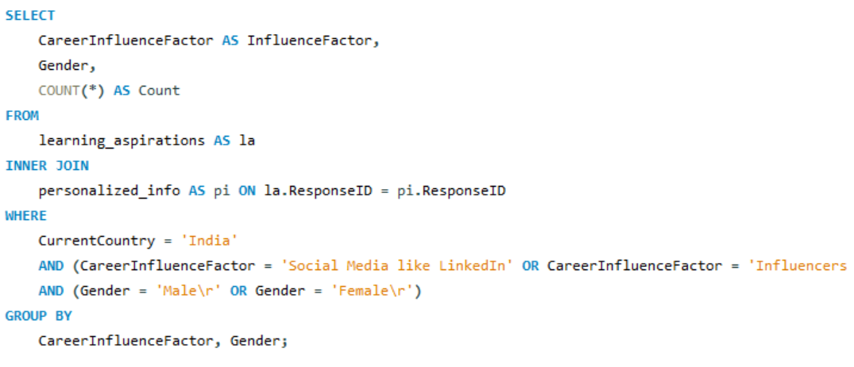

Slide 12
STAGE 4:
ANALYZING
IN SQL

Slide 13
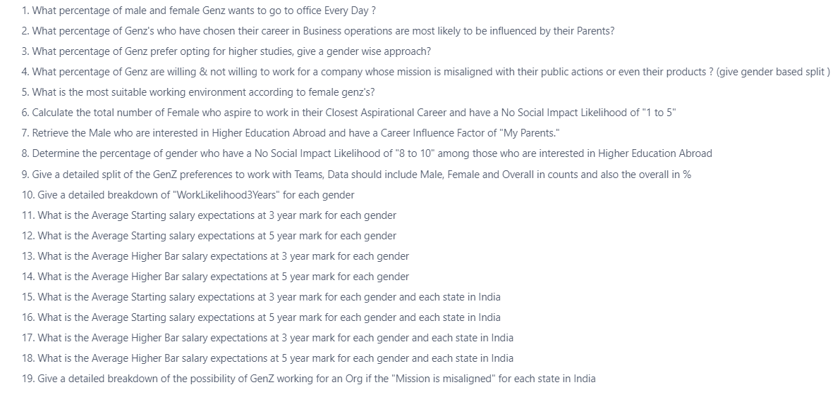

Slide 14
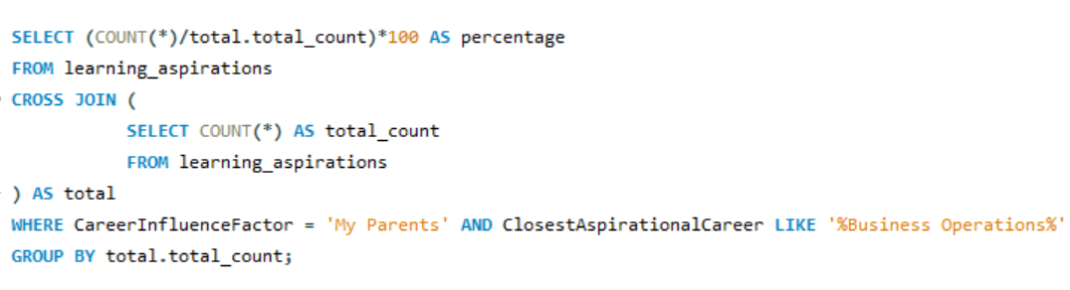
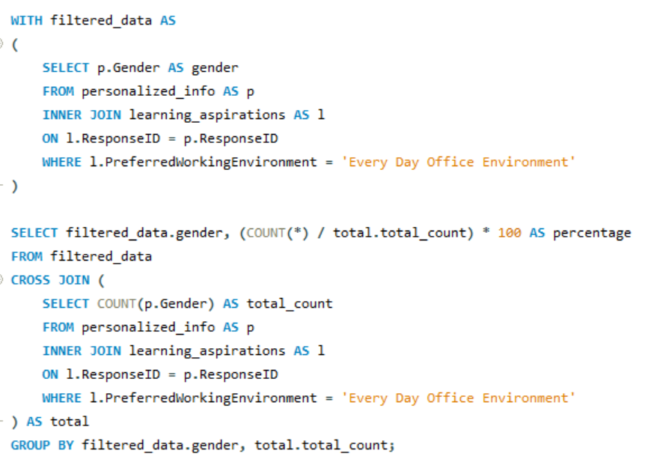
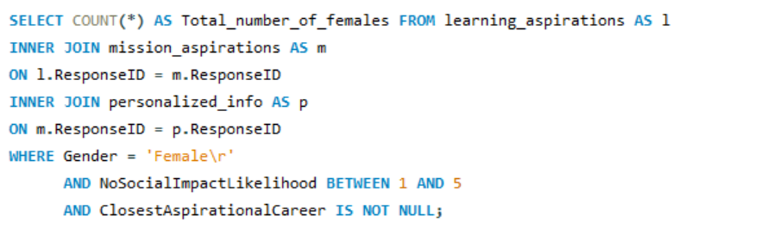

Slide 15
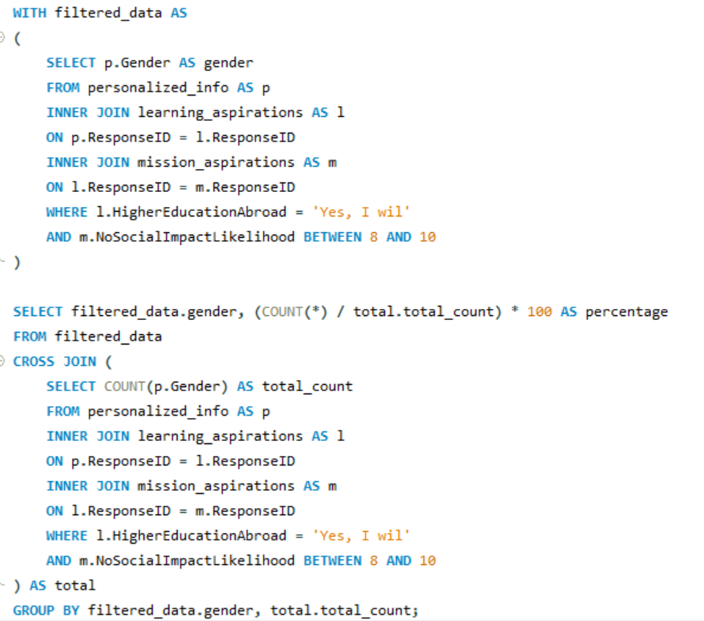
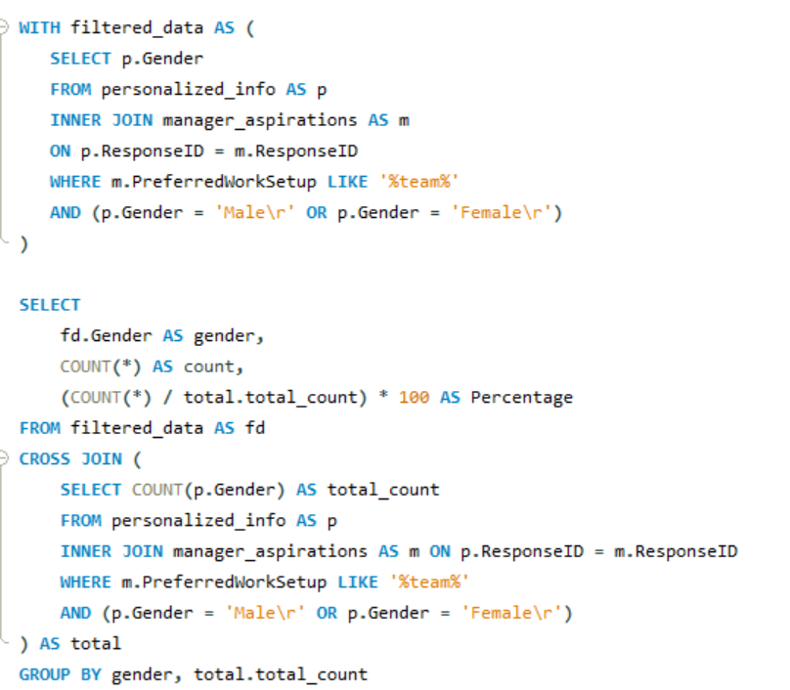
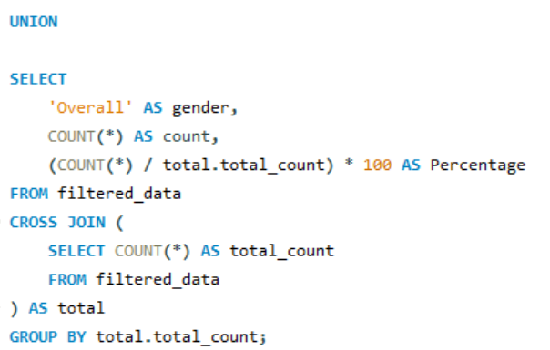

Slide 16
STAGE 5:
GENERAL EXCEL
DASHBOARD

Slide 17
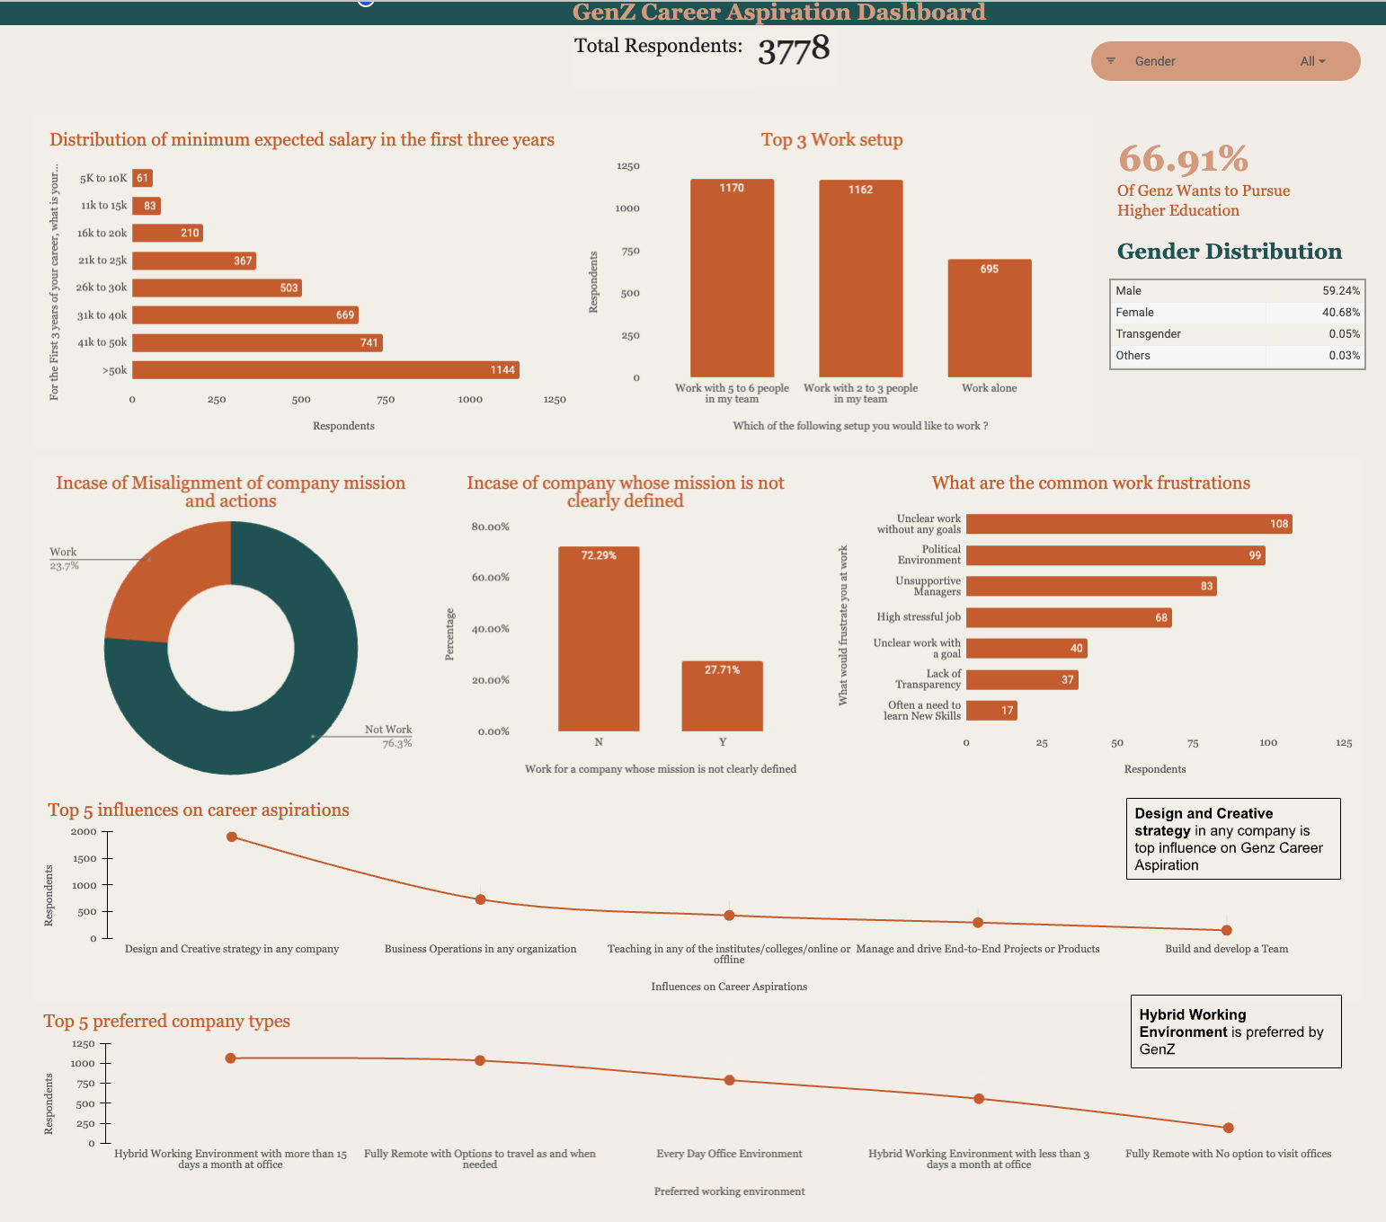

Slide 18
STAGE 6:
FOCUS AREA DRIVEN
EXCEL DASHBOARD

Slide 19
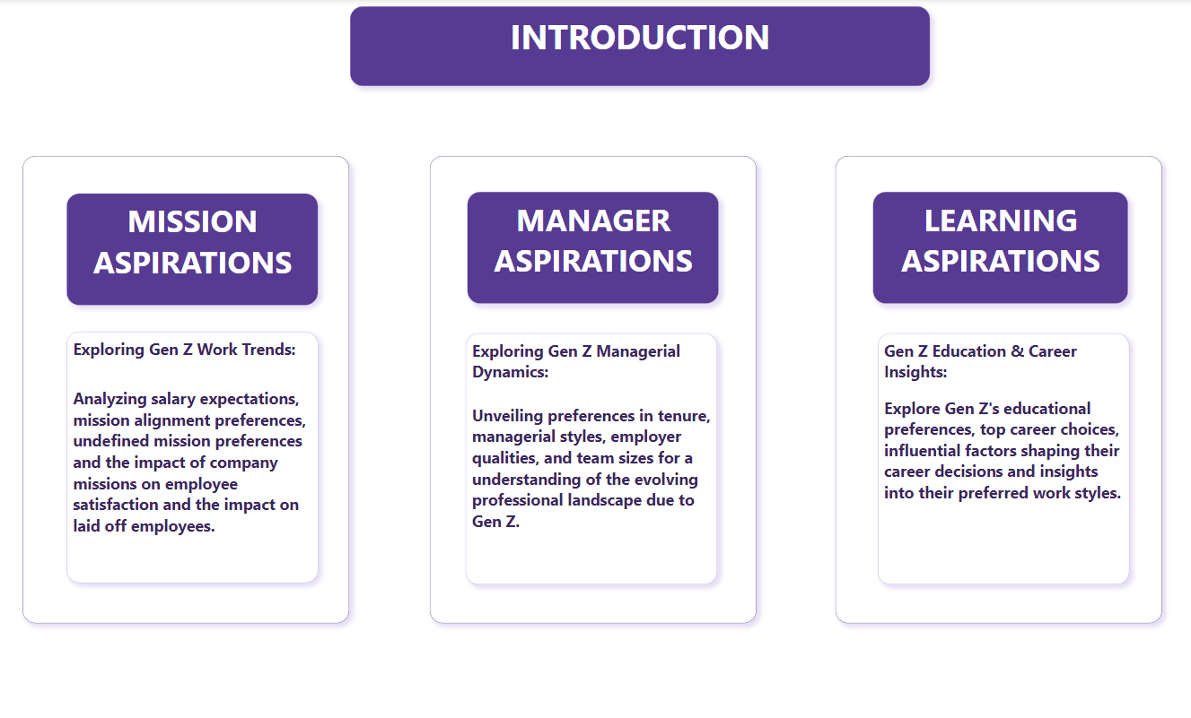

Slide 20
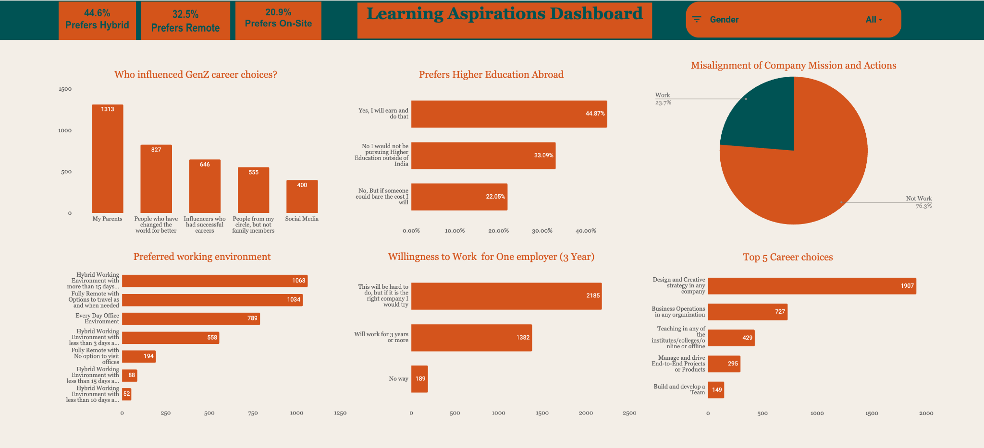

Slide 21
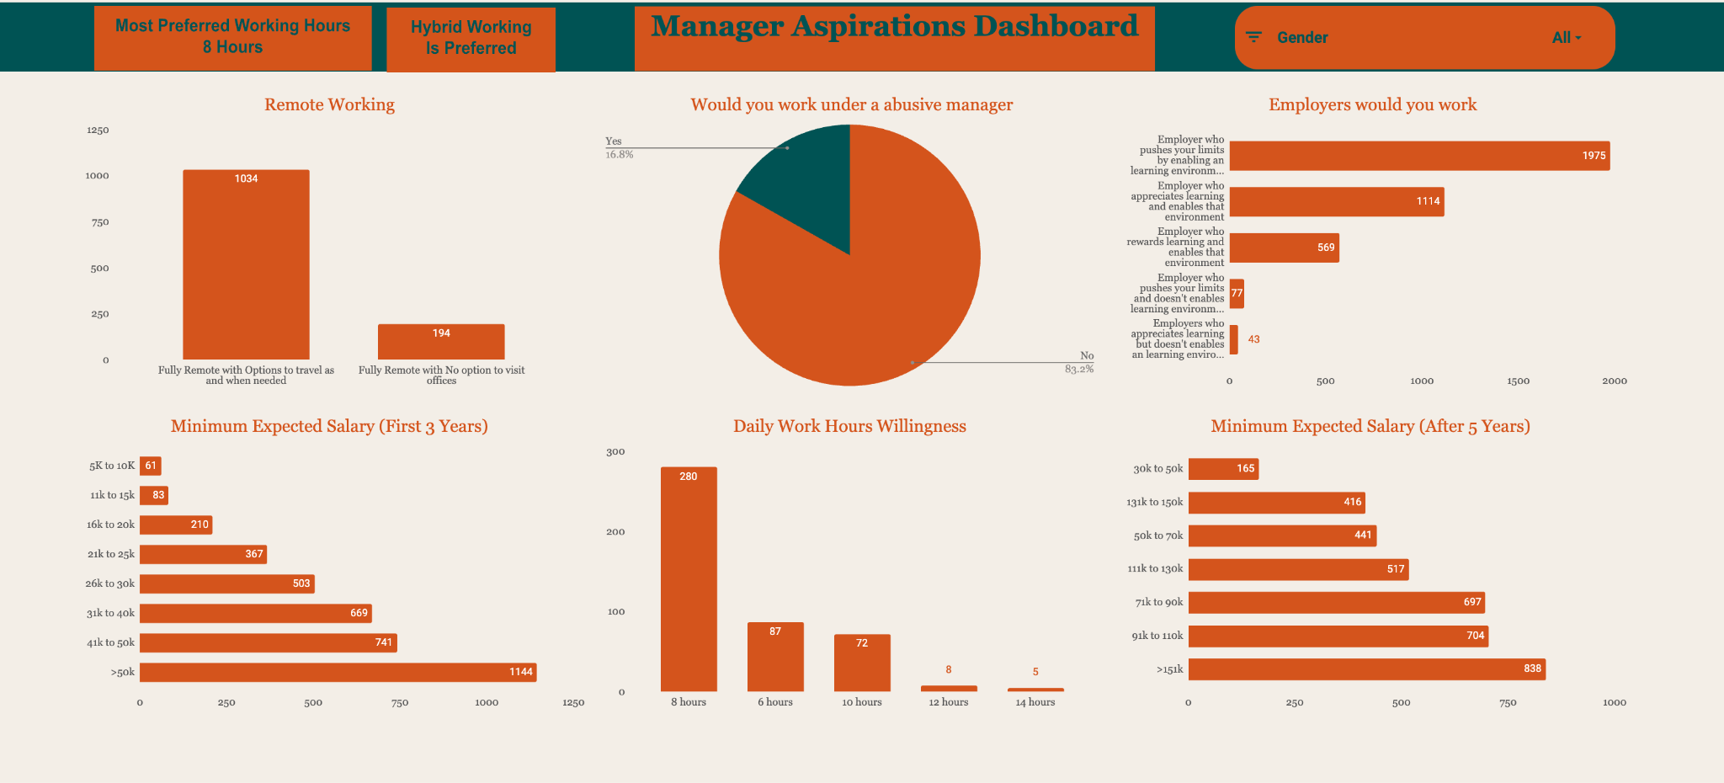

Slide 22
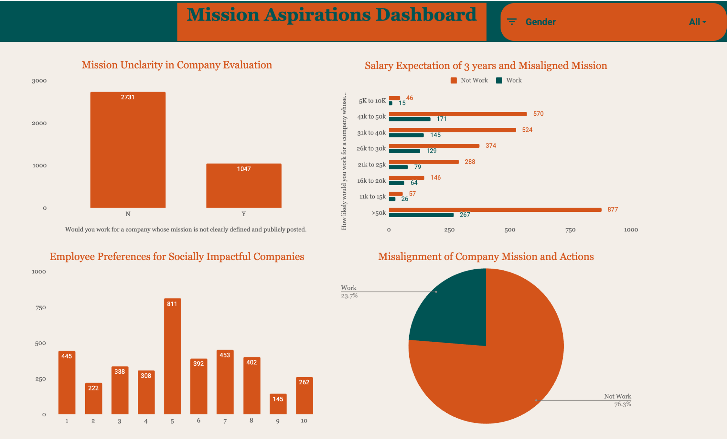

Slide 23
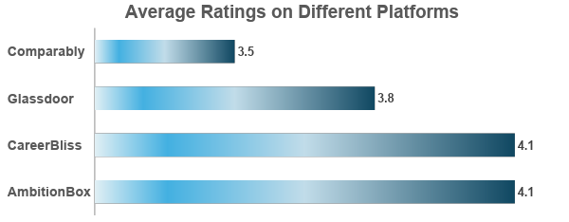
Average Rating
3.9

Slide 24
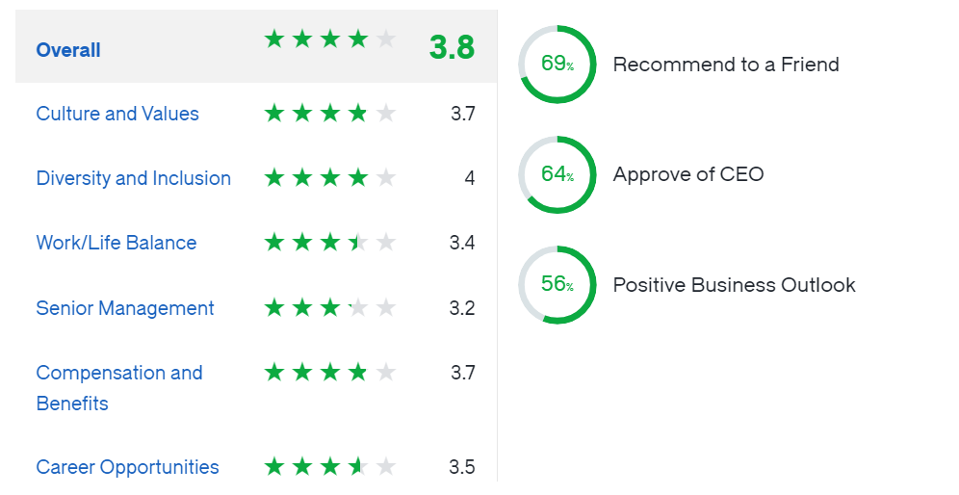
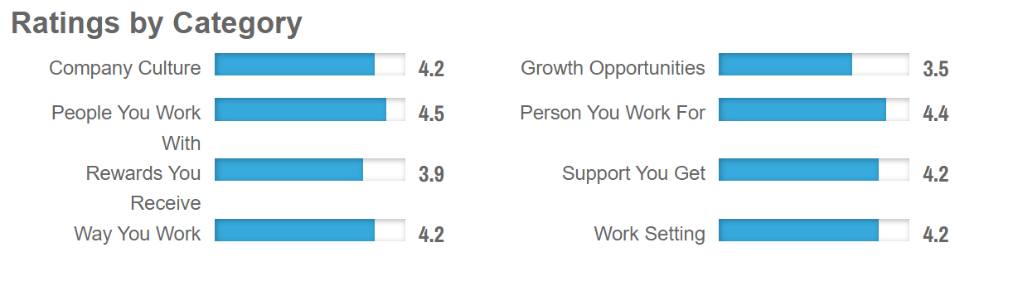
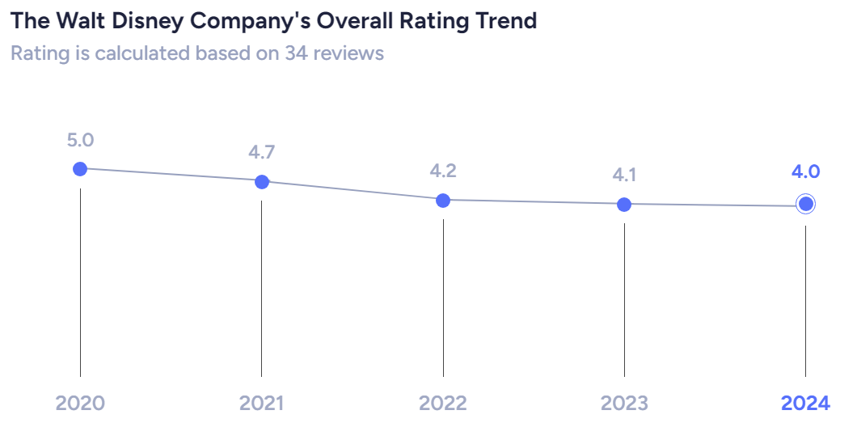
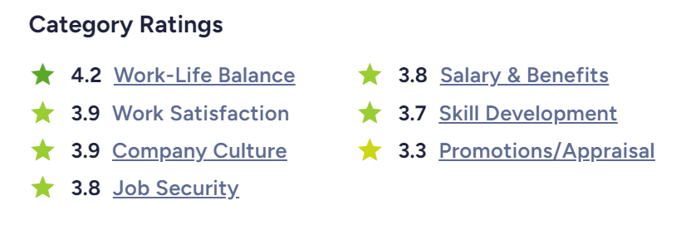
GLASSDOOR
CAREERBLISS
AMBITIONBOX
AMBITIONBOX

Slide 25
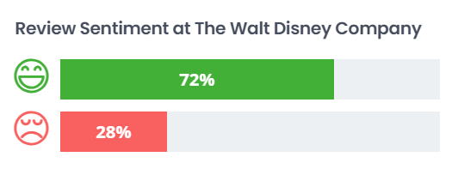
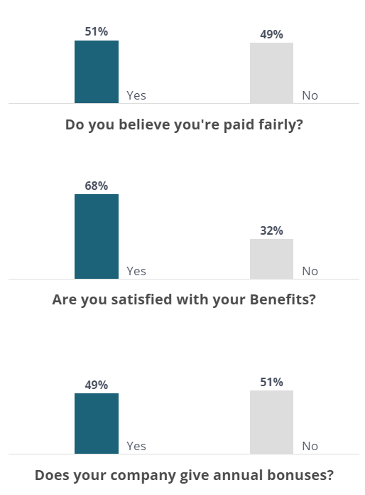
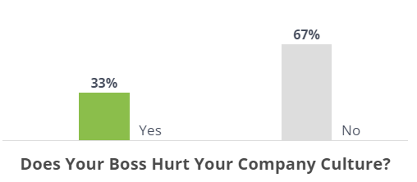
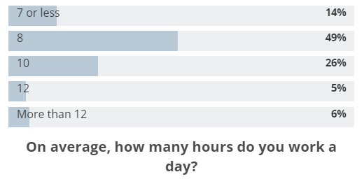
COMPARABLY
COMPARABLY
COMPARABLY

Slide 26
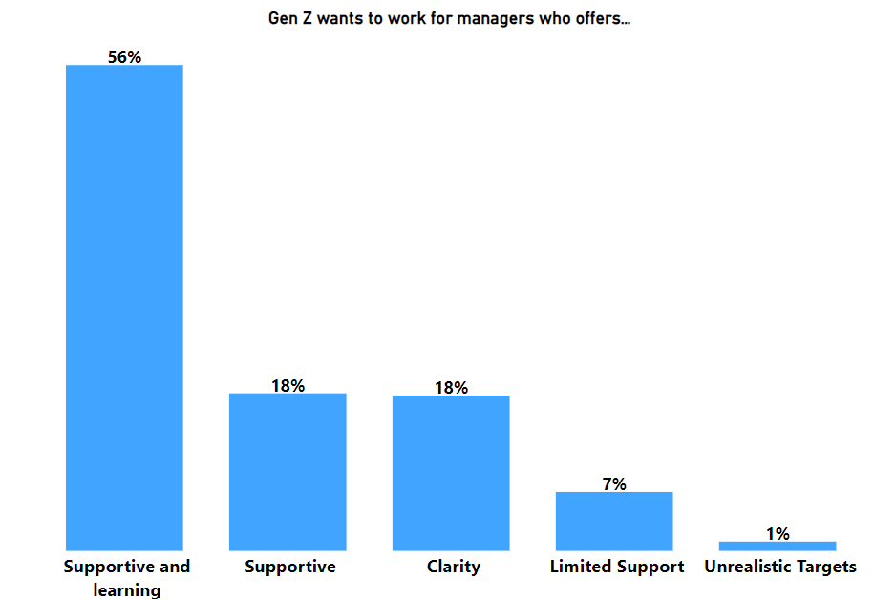
INSIGHTS
PROBLEM
Poor Managers or Leadership
RECOMMENDATIONS
Invest in leadership development programs
Implement a feedback system
Schedule regular meetings with the managers and teams to ensure open communication

Slide 27
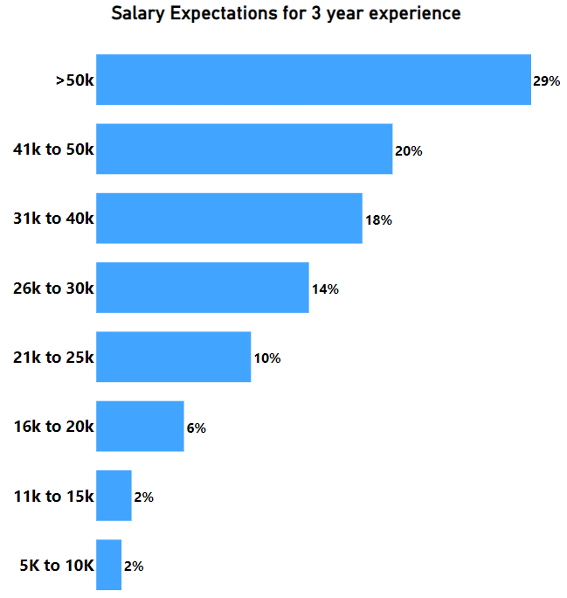
INSIGHTS
PROBLEM
Poor or Low Salaries
RECOMMENDATIONS
Conduct regular market research
Implement performance-based pay
Communicate openly about the company's financial situation
Enhance non-monetary benefits such as health insurance, flexible work hours or professional development opportunities

Slide 28
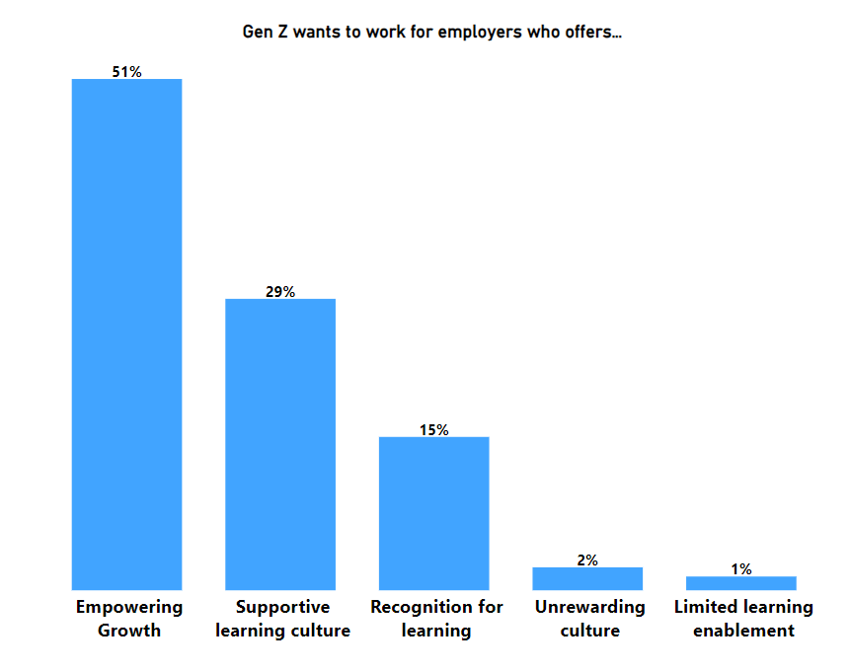
INSIGHTS
PROBLEM
Stagnant Growth
RECOMMENDATIONS
Create personalized career development plans
Provide constructive feedback
Establish clear criteria for promotions
Encourage cross-functional projects
Recognize and celebrate employees’ achievements

Slide 29
THANK YOU!!

